Slide 1
#LearnDocker Workshop
Docker 101 for Developers

Slide 2
This Docker 101 workshop is designed to get you up and running with containers!
What you’ll learn today:
How to build images
Run containers
Use volumes to persist data and mount in source code
Define your application using Docker Compose.
A few advanced topics!
Networking
Image building best-practices
#LearnDocker, ask questions and most importantly, have fun!

Slide 3
The Basics!

Slide 4
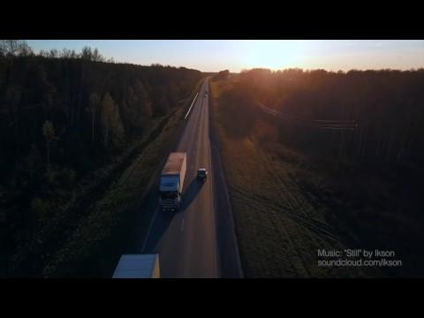
Notes:
Docker is a platform for developers and sysadmins to build, share, and run applications with containers. Containers are not new, but their use for easily deploying applications is.
Containerization is increasingly popular because containers are:
Flexible: Even the most complex applications can be containerized.
Lightweight: Containers leverage and share the host kernel, making them much more efficient in terms of system resources than virtual machines.
Portable: You can build locally, deploy to the cloud, and run anywhere.
Loosely coupled: Containers are highly self sufficient and encapsulated, allowing you to replace or upgrade one without disrupting others.
Scalable: You can increase and automatically distribute container replicas across a datacenter.
Secure: Containers apply aggressive constraints and isolations to processes without any configuration required on the part of the user.
Facts: By 2020, more than 50% of global organizations will be running containers in production

Slide 5


Developers love Docker
1st
2nd
3rd
Most Wanted Platform
Most Loved Platform
Most Used Platform
Notes:
The Stack Overflow 2019 survey results of over 90,000 developers:
Docker has ranked
3rd in the Most used platform (after windows and linux!)
2nd in the “Most Loved” platform and the
1st in the Most Wanted” platform

Slide 6
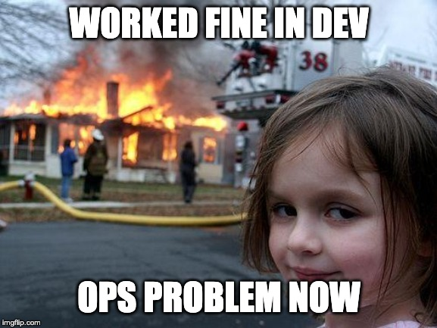
Notes:
Docker helps solve this problem, which many of you can probably relate to. It helps build one environment and share it everywhere, rather than requiring everywhere that runs the code to have the same environment it was developed in. How do we do that? We use images.

Slide 7
What is an image?
A fully self-contained “thing” that contains everything an app needs to run
Application source code
All runtime dependencies, config files, and binaries
At the end of the day, think of it as simply a transportable file system
Notes:
While we’ll dive into images in the workshop, remember that images are simply a self-contained package that contains everything needed to run an app.
Think of it as a portable USB drive that you can plug into a machine and then have everything needed to run a specific application.

Slide 8
Important Note:
Images are STATELESS and IMMUTABLE
Notes:
One of the most important aspects of container isolation is that each container interacts with its own, private filesystem; this filesystem is provided by a Docker image. An image includes everything needed to run an application -- the code or binary, runtimes, dependencies, and any other filesystem objects required.

Slide 9
Creating Images
Best practice is to use a Dockerfile
A text file that contains a script used to create an image
Allows various commands, including:
FROM - specify the parent image (almost always the first command)
COPY - copy files from the host into the image
RUN - run a command using binaries inside the container (install services, etc.)
CMD - specify the default command (if one not specified in parent image)
Notes:
The best practice to create images are to use a Dockerfile. Think of the Dockerfile simply as a set of instructions to create the portable filesystem. Since it’s a text-based “script”, it can be version controlled, shared with others, and used to create reproducible environments.

Slide 10
Sharing Images
After building an image, it’s only available on the machine that built it
To share, you have to push to a registry
Docker Hub is the default registry
Many other third-party offerings available too
Once pushed to the registry, others can pull the image
Notes:
Once we’ve created this portable filesystem, we probably want to share it with others. To do so, we use a container registry. Docker Hub is the default one, but there are many others available.

Slide 11
What’s a container then?
While a container looks like a VM, it isn’t!
A container is JUST another process on the machine
It uses namespaces and control groups (cgroups) to provide isolation
Namespaces include network, process, user, IPC, mount, and others
The filesystem for the image comes from an image

Slide 12
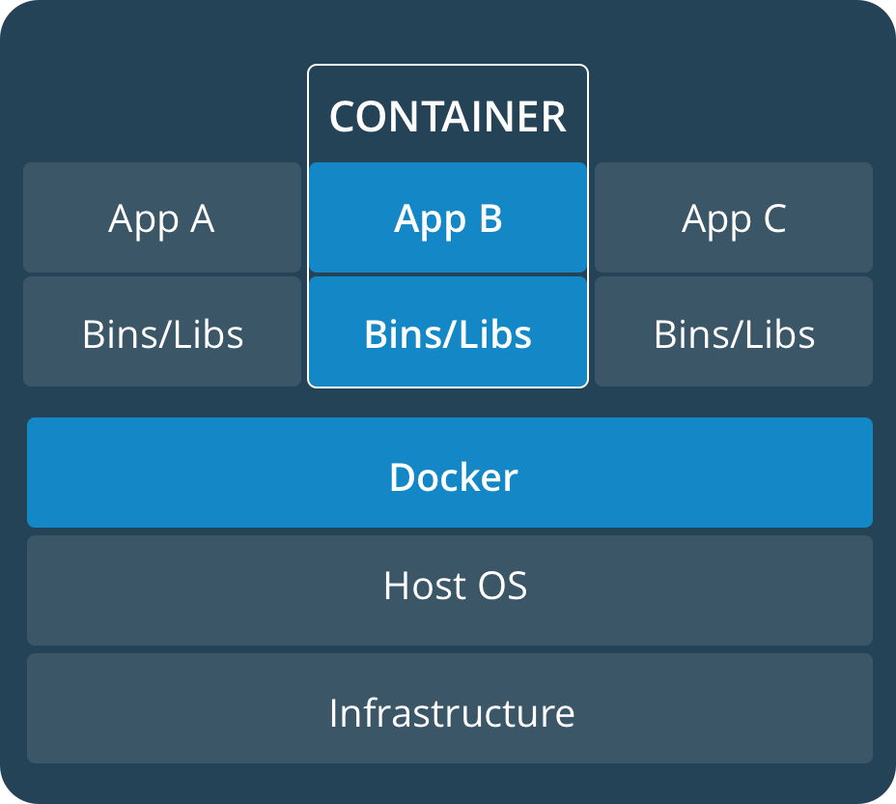
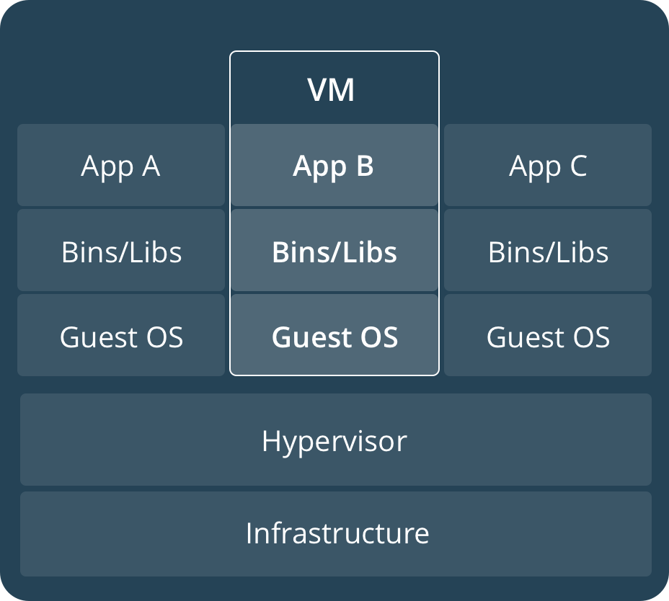
Container versus VM
Notes:
It’s important to recognize that containers share the same Host OS, while VMs each provide their own OS. One important point of recognition is that Docker does NOT replace the hypervisor. It is not translating syscalls, but merely helping setup the isolation boundaries between containers. Once the container (process) is up and running, the container engine is out of the way and the process is running directly on the Host OS.

Slide 13


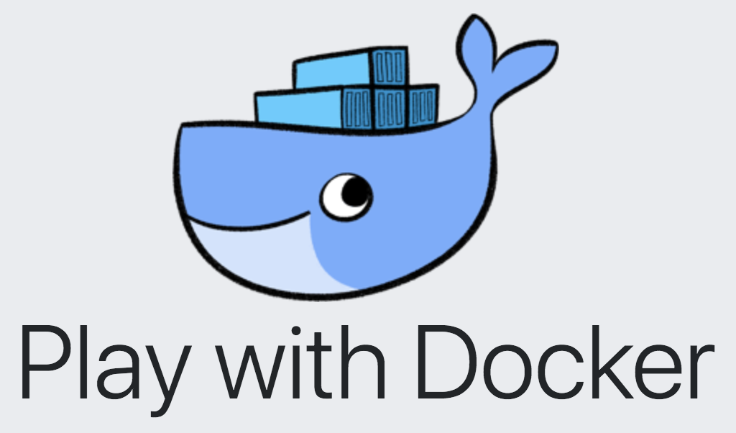
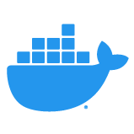
Docker Desktop
MacOS and Windows apps that allow you to easily set up Kubernetes or Swarm on your local development machine
Docker Hub
The world’s largest repo for finding or sharing container images with others
Play with Docker
A Docker playground which allows users to run Docker commands for workshops + learning

Slide 14

Go time!
URL: https://dockr.ly/dev101

